Slide 1
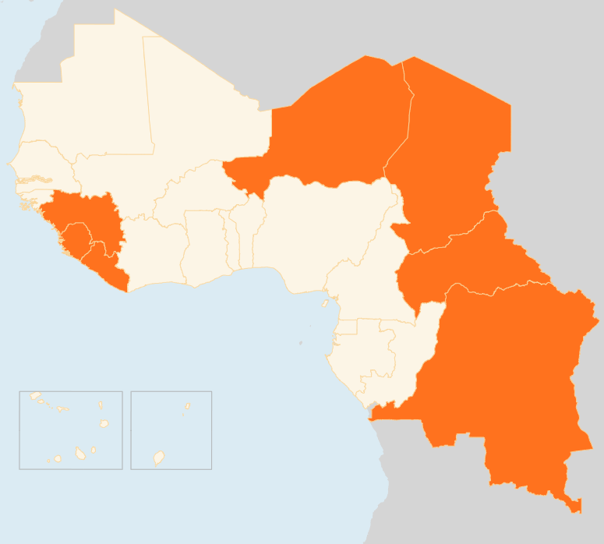


14 – 20 July 2015
CENTRAL AFRICAN REPUBLIC (CAR)
Number OF IDPs decreases by 30,000
The number of IDPs across the country dropped to 368,859 in July from 399,268 in May (7.6 percent). This includes IDPs in 32 sites in the capital Bangui where there currently are 30,186 IDPs down from 33,067 in May, according to the Population Movement Commission. The returns are mostly due to the relative improvement of security in some parts of the country, but particularly as a result of the increased presence of MINUSCA forces in some areas of return. However, there are primary and secondary movements with the emergence of new IDPs sites in the Ouham and Nana-Gribizi provinces in the central and north-western regions.
CHAD
INSECURITY HAMPERS RESPONSE IN LAKE REGION
Recurrent attacks by suspected Boko Haram militants have heightened insecurity in the southern Lake Region. On 17 July, Chadian forces repulsed an attack by Boko Haram militants on the village of Koumguia. One Chadian soldier and 19 militants were killed in the fighting, according to media reports. Koumguia was the fourth locality on the shores of Lake Chad to be attacked in a week, forcing humanitarian agencies to reduce their activities. The protection, security and relief assistance to the affected population are the key concerns.
DRC
9 KILLED IN MILITANT ATTACK
On 14 July, at least nine people were killed during an attack in Beni area in North Kivu province allegedly committed by Ugandan Allied Democratic Forces rebels. The attack targeted several villages about 60 km north of Beni.
MEASLES OUTBREAK IN MANIEMA
On 15 July, the authorities in the eastern Maniema province declared a measles epidemic in Kasongo health zone where some 300 measles cases have been recorded, and called on humanitarian partners for assistance to curb the spread of the disease. There are few humanitarian health actors presently operating in Maniema.
NIGER
INFLUX OF DISPLACED FROM NIGERIA
Several groups of displaced people have been recorded in Gagamari and Chetamari areas of Diffa in southern Niger in recent days. The displaced are arriving from the Nigerian town of Damassak just south of the Niger-Nigerian border owing to reports of an impending withdrawal of Chadian and Nigerien forces from the town where they drove off Boko Haram insurgents earlier this year. Shelter, food and water are the main needs of the displaced. Humanitarian partners are to meet with the Governor to plan the provision of temporary emergency assistance to the most vulnerable people.
15 KILLED IN ATTACK
On the night of 15 July, 15 people were killed and five others wounded during an attack on Ngougouroum village in Bosso in southern Niger, which has come under repeated attacks by suspected Boko Haram militia. The raid also forced villagers to flee for safety in neighbouring localities.
EVD REGIONAL
AREAS OF TRANSMISSION SHIFTS TO CAPITAL CITIES
No new cases were reported this week in Liberia, which previously reported six confirmed cases and two deaths after Ebola resurfaced in the country in the last week of June. The source of the transmission is still unknown. In Guinea, as of 19 July, four new cases were reported and in Sierra Leone two confirmed cases were recorded - one in each of the two hotspot districts of Port Loko and Western Urban Area. In the week to 12 July, there were a total of 30 cases from the three countries, according to WHO, which noted that for the first time in several months, most of the cases in Guinea and Sierra Leone occurred in their capital cities and were on a list of known contacts or an established transmission chain.
NIGER
CHAD
IDP INFLUX FROM NIGERIA
SECURITY WORSENS IN LAKE REGION
15
KILLED IN RAID
CAR
30k
IDP NUMBERS DROP
EVD REGIONAL
6
NEW CASES
DRC
9
KILLED IN ATTACK
Creation date: 22 July 2015
Map data sources: UNCS, DevInfo, OCHA.
The boundaries and names shown and the designations used on this map do not imply official endorsement or acceptance by the United Nations

